Slide 1

CMR TECHNICAL CAMPUS Accredited by NBA, Approved by AICTE, affiliated to JNTUH Kandlakoya (V), Medchal Road, Hyderabad -501401 UGC AUTONOMOUS Predictive analysis for supermarket sales using machine learning
Under the guidance of
D Mounika Team members:
Aditya Singh(187R1A05C4)
Abhinav Dharipalli(187R1A05E0)
Rama Krishna Bollepally(187R1A05C6)

Slide 2
Contents
Abstract
Existing system
Disadvantages of existing system
Proposed system
Advantages of proposed system
Hardware requirements
Software requirements
Project Architecture
Modules
UML diagrams
Conclusion

Slide 3
ABSTRACT
Estimating future sales is an important aspect of any business. Accurate prediction of future sales help companies to develop and improve business strategies as well as to gain proper market knowledge. Standard sales forecast helps companies to analyze the situation which has occurred before and then apply customer purchase inferences to identify inadequacies and weaknesses before budgeting as well as to prepare good plan for the next year. A detailed knowledge of past opportunities permits one to plan for future market needs and increase the possibility of success

Slide 4
PROBLEM STATEMENT
Currently, Big Marts keep track of each individual item’s sales data in order to anticipate potential consumer demand and update inventory management.
With the help of data science, engineers help the marts by predicting the sales per product. By good prediction the products can be sold efficiently and stores can generate good profits from them.
Anomalies and general trends are often discovered by mining the data warehouse’s data store. For retailers like Big Mart, the resulting data can be used to forecast future sales volume using various machine learning techniques.
A predictive model can be developed using Xgboost, Linear regression, Polynomial regression, and Random Forest techniques for forecasting the sales of a business.

Slide 5
Existing approach
In the current big-mart, many products will be available but the owner or a salesmen cannot know which product will have high demand.
The basic and foremost technique used in the sales is the statistical methods, which is also known as traditional methods, but these methods much more time for predicting the sales and also these methods could not handle the non-linear data so to overcome these problems in the traditional methods machine learning models are deployed.

Slide 6
Disadvantages
Waste of time and traveling cost.
Shortage of products or over stock of products may occur.
Does not work efficiently for many big cities.
There is a need to maintain a large number of employees for surveying.

Slide 7
Proposed approach
In this project we are going to develop a machine learning model to predict the future demand of products from a particular mart. We are going to perform all the operations on big-mart dataset. We will try to perform data cleaning and apply classifiers like Linear Regression, Random Forest, Decision Trees, XGboost and other machine learning algorithms.
We will check the accuracy of our developed machine learning model using python libraries. The model will predict the both minimum and maximum demand for the product. This approach may be useful and overcome the disadvantages of the existing approach.

Slide 8
Advantages of proposed system
No Waste of time and No traveling cost
No Shortage of products or over stock of products may occur.
Work efficiently for many big cities.
There is a no need to maintain a large number of employees for surveying.

Slide 9
Hardware requirements
Operating system: Windows 10.
System architecture: 64-bit X86 with windows or Linux
CPU: Intel core i5
RAM: 8GB.

Slide 10
Software requirements
Operating system : Windows 7,8,10
Coding Language : python
Tool : Google collaboratory

Slide 11
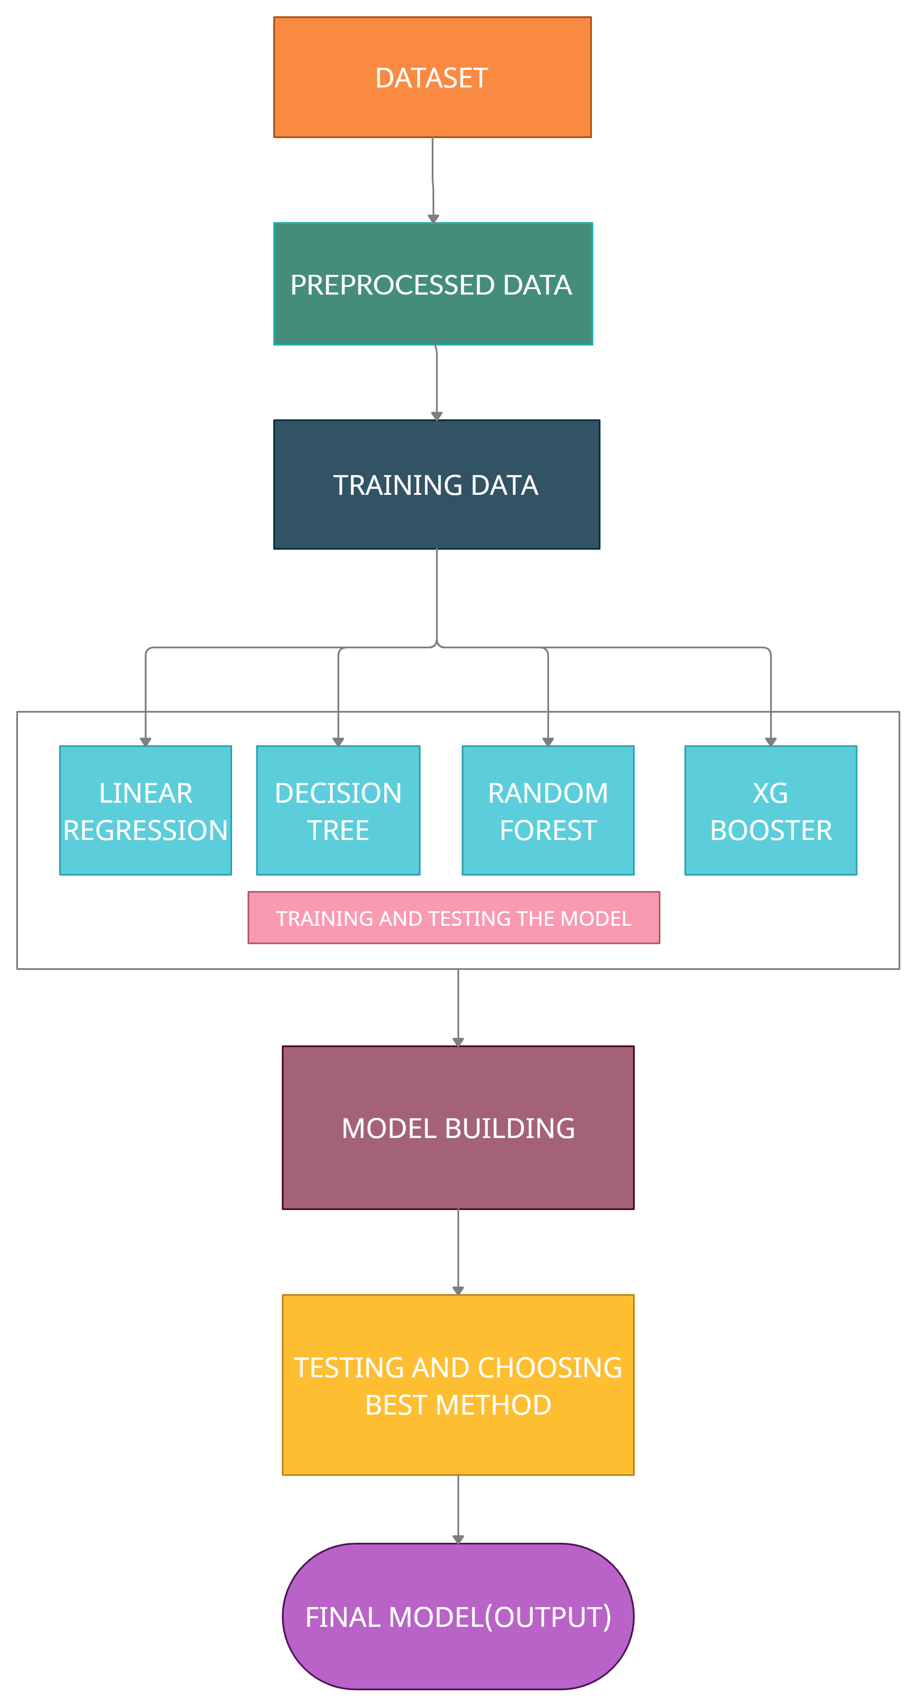
Project Architecture

Slide 12
Modules
Module 1: Data Preprocessing
This module mainly deals with data preprocessing. The dataset may contains null values or outliers. The noise in the data may effects the accuracy of the model.
Attributes in dataset:-
Item identifier
Item weight
Item type
Item mrp
Outlet Identifier
Outlet size
Outlet establishment year
Outlet location type
Item outlet sales
Outlet type

Slide 13
Modules
Module 2: Splitting and Training
Whole dataset split in to 2 parts Testing dataset(test.csv) and training dataset(train.csv).
We will build various machine learning models with many ML algorithms like linear regression, Random forest, Xgboost. Both testing and training will be performed using all of these algorithm.
Module 3: Final Output
In this module we mainly deals with comparison of results obtained by above machine learning algorithms.
Finally the algorithm with maximum accuracy and less error rate will be chosen and this module also deals with data visualization all the required graphs will be displayed to the user.

Slide 14
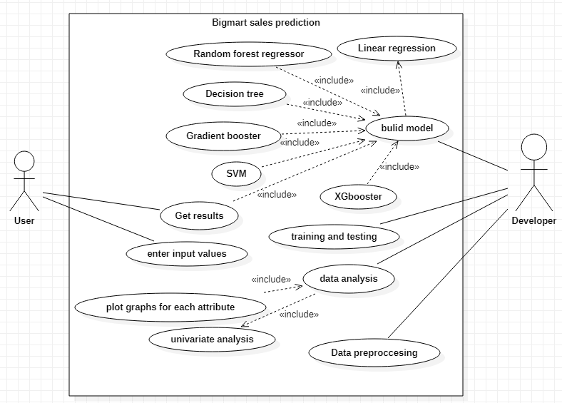
USECASE DIAGRAM

Slide 15
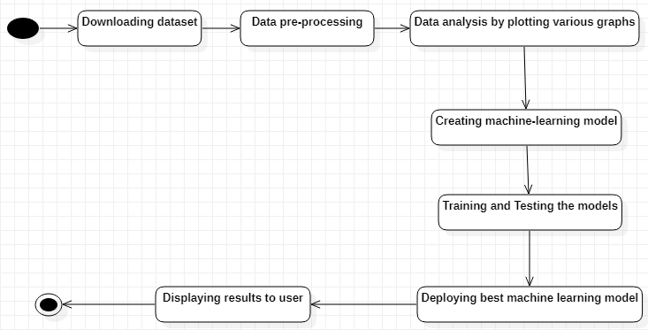
ACTIVITY DIAGRAM

Slide 16
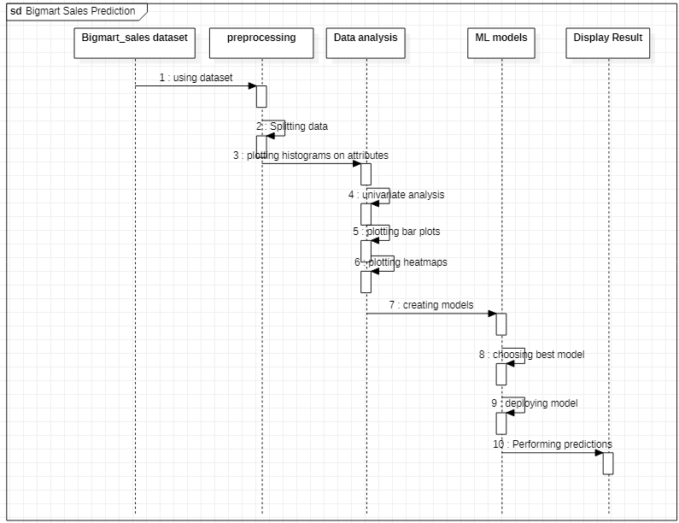
SEQUENCE DIAGRAM

Slide 17
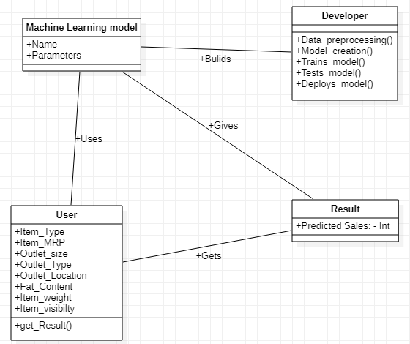
CLASS DIAGRAM

Slide 18
import numpy as np
import pandas as pd
import seaborn as sns
import matplotlib.pyplot as plt
%matplotlib inline
import warnings
warnings.filterwarnings('ignore')
# Measuring Accuracy
from sklearn.metrics import accuracy_score, r2_score, mean_squared_error
from sklearn.model_selection import cross_val_score
from sklearn import metrics
df=pd.read_csv("/content/Bigmart1.csv")
df.head()
print(df.shape)
print(df.size)
df.describe(include='all')
df.isnull().sum()
sns.heatmap(df.isnull(), yticklabels=False, cbar=False, cmap='viridis')

Slide 19
from sklearn.model_selection import train_test_split
X_train, X_test, y_train, y_test = train_test_split(X, y, test_size=0.30, random_state=101)
Building regression model
from sklearn.linear_model import LinearRegression
lm = LinearRegression(normalize=True)
lm.fit(X_train, y_train)
Prediction and evaluation
predict = lm.predict(X_test)
print('Score: ')
lm.score(X_test, y_test)
#r2_score(y_train, lm.predict(y_test))
Random forest regressor
from sklearn.ensemble import RandomForestRegressor
rf = RandomForestRegressor()
rf.fit(X_train, y_train)
Prediction and evalution
rfpredict = rf.predict(X_test)
print('Score: ')
rf.score(X_test, y_test)

Slide 20
Decision tree model
# Fitting Decision Tree Regression to the dataset
from sklearn.tree import DecisionTreeRegressor
regressor = DecisionTreeRegressor(max_depth=15,min_samples_leaf=300)
regressor.fit(X_train, y_train)
tree_accuracy = round(regressor.score(X_train,y_train),2)
tree_accuracy
r2_score(y_train, regressor.predict(X_train))
XGBooster
from xgboost import XGBRegressor
regressor=XGBRegressor()
regressor.fit(X_train,y_train)
y_pred = regressor.predict(X_test)
print(y_pred)
# Calculating the RMSE Score
mse = mean_squared_error(y_test, y_pred)
print("RMSE :", np.sqrt(mse))
regressor.score(X_test, y_test)

Slide 21
FUTURE ENHANCEMENTS :
Till now we have completed all the data pre-processing and data visualization part. We need to explore on more machine learning models in future to attain good accuracy and precision. We also are trying to create good front end to our project. Such that user can easily interact with our application.We are planning to write and publish the paper on our project. We are stilling in planning phase we will start writing the paper with in short time. We are planning to add more graphs and plots in data visualization so that we can study every attribute and can decide how to deal with machine learning models.

Slide 22
Conclusion
In present era of digitally connected world every shopping mall desires to know the customer demands beforehand to avoid the shortfall of sale items in all seasons.
The Project focuses on predicting the future demand of the products in a mart using machine learning techniques.
The store managers can make use of this system to know the future demand and stock up goods in their market accordingly.
This system avoids situations of over stock and under stock if predicted rightly.

Slide 23
References
[1] https://www.kaggle.com/yonatanrabinovich/bigmart-sales-data-analysis-and-prediction sales data for 1559 products across 10 stores in different cities
[2] Beheshti-Kashi, S., Karimi, H.R., Thoben, K.D., L¨utjen, M., Teucke, M.: A survey on retail sales forecasting and prediction in fashion markets. Systems Science & Control Engineering 3(1), 154–161 (2015)
[3] Blog: Dataaspirant, “HOW THE RANDOM FOREST ALGORITHM WORKS IN MACHINE
LEARNING”, (URL: https://dataaspirant.com/2017/05/22/random-forest-algorithm-machine-learing/.).
[4] Mohit Gurnani, Yogesh Korke, Prachi Shah, Sandeep Udmale, Vijay Sambhe, Sunil Bhirud, “Forecasting of sales by using fusion of machine learning techniques”,2017 International Conference on Data Management, Analytics and Innovation (ICDMAI), IEEE, October 2017.
[5] Kadam, H., Shevade, R., Ketkar, P. and Rajguru.: “A Forecast for Big Mart Sales Based on Random Forests and Multiple Linear Regression.” (2018).

Slide 24

THANK YOU.

